Slide 1
8086/8088 Instruction Set, Machine Codes and Addressing Modes

Slide 2
Software
The sequence of commands used to tell a microcomputer what to do is called a program,
Each command in a program is called an instruction
8086 understands and performs operations for 133 basic instructions
A program written in machine language is referred to as machine code
In 8088 assembly language, each of the operations is described by alphanumeric symbols instead of 0-1s.
ADD AX, BX
(Opcode) (Destination operand) (Source operand )

Slide 3
Instructions
LABEL: INSTRUCTION ; COMMENT
Address identifier Does not generate any machine code
Ex. START: MOV AX, BX ; copy BX into AX
There is a one-to-one relationship between assembly and machine language instructions
A compiled machine code implementation of a program written in a high-level language results in inefficient code
  – More machine language instructions than an assembled version of an equivalent handwritten assembly language program

Slide 4
Two key benefits of assembly language programming
  – It takes up less memory
  – It executes much faster

Slide 5
Applications
One of the most beneficial uses of assembly language programming is real-time applications.
Real time means the task required by the application must be completed before any other input to the program that will alter its operation can occur
For example the device service routine which controls the operation of the floppy disk drive is a good example that is usually written in assembly language

Slide 6
Assembly language not only good for controlling hardware devices but also performing pure software operations
  – Searching through a large table of data for a special string of characters
  – Code translation from ASCII to EBCDIC
  – Table sort routines
  – Mathematical routines
Assembly language: perform real-time operations
High-level languages: used to write those parts that are not time critical

Slide 7

Converting Assembly Language Instructions to Machine Code
An instruction can be coded with 1 to 6 bytes
Byte 1 contains three kinds of information
  – Opcode field (6 bits) specifies the operation (add, subtract, move)
  – Register Direction Bit (D bit) Tells the register operand in REG field in byte 2 is source or destination operand
  1: destination 0: source
  -Data Size Bit (W bit) Specifies whether the operation will be performed on 8-bit or 16-bit data
  0: 8 bits 1: 16 bits

Slide 8
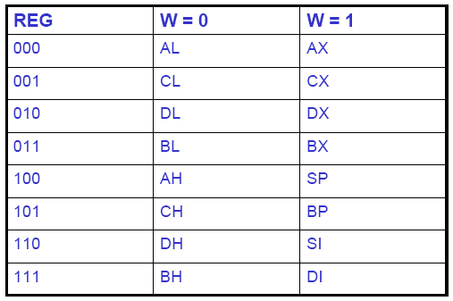
Byte 2 has three fields
– Mode field (MOD)
– Register field (REG) used to identify the register for the first operand
– Register/memory field (R/M field)

Slide 9
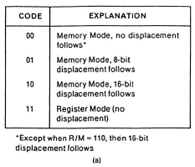
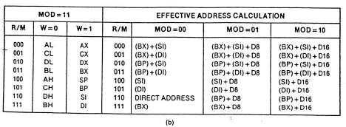
2-bit MOD field and 3-bit R/M field together specify the second operand
Mode Field encoding
Register/memory (R/M) Field Encoding

Slide 10
Examples
MOV BL,AL (88C3₁₆)
Opcode for MOV = 100010
D = 0 (AL source operand)
W bit = 0 (8-bits)
Therefore byte 1 is 10001000₂=88₁₆
• MOD = 11 (register mode)
• REG = 000 (code for AL)
• R/M = 011 (destination is BL)
Therefore Byte 2 is 11000011₂=C3₁₆

Slide 11
Examples:
MOV BL, AL = 10001000 11000011 = 88 C3h
ADD AX, [SI] = 00000011 00000100 = 03 04 h
ADD [BX] [DI] + 1234h, AX = 00000001 10000001 __ __ h = 01 81 34 12 h

